Slide 1
The Farmer Problem
CS 142
David Anderson
Adapted from slides by Martin Hock

Slide 2
Group Project Specification
Now that you have your group project idea solidified, the next step is to break this idea down into a specification.
You can think of the specification as a collection of requirements. The process of developing these requirements is called requirements engineering.
Each requirement is a functionality your software shall provide.
Requirements are atomic – broken down into small pieces, as simple as possible (simpler things are easier to test!).
Example Requirement (hangman software): Software shall pick a secret phrase from a collection of phrases stored in a file.
We won’t cover requirements engineering much more than this but knowing about it will be useful in future engineering courses.

Slide 3
Why bother specifying requirements?
Breaking down software into requirements helps identify and resolve problems before implementation.
Example: a client asks us to build a luxury car.
We build the client a Lexus (our definition of luxury).
We present the Lexus to the client and they are unhappy, they were expecting a Bentley (their definition of luxury).
Rebuilding a new car is much more expensive than identifying this ambiguity at the requirements engineering stage.
English is ambiguous. Building a structured set of requirements helps alleviate this.

Slide 4
Group Project Specification
Since this is a short quarter, for your group projects you will be doing both specification and implementation in parallel.
Writing this specification is good practice for future engineering courses.
50% of your group project grade comes from this specification document and 50% comes from implementation.
I will post an example simple software specification template soon, but for now, focus on breaking down your project into a collection of simple atomic requirements.

Slide 5
The Farmer Problem
A farmer wants to transport a wolf, a goat, and a cabbage across a river. The farmer has a boat, but it can only hold herself and one other thing (she has to be in the boat to pilot it). If the farmer leaves the wolf and goat alone with each other, the wolf eats the goat. If the farmer leaves the goat and cabbage alone with each other, the goat eats the cabbage. Can the farmer transport all three things across the river without anything being eaten?

Slide 6
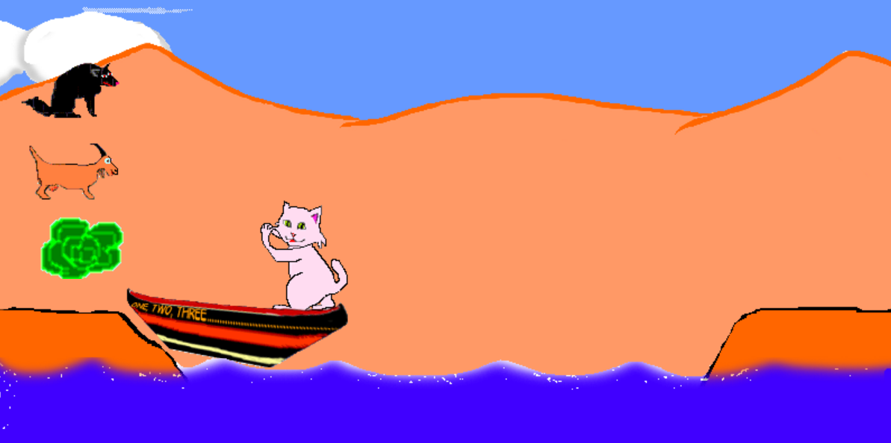
Online version

Slide 7
Implementing the farmer problem’s rules
When we play the farmer problem game, a computer program enforces the rules of the game
The program can prevent us from making a move that violates a rule
Let’s implement Java code which allows us to try making a single move and checks whether that move is allowable

Slide 8
Modeling the Farmer Problem
There are four objects: the wolf, goat, cabbage, and boat
There is also the farmer, but the farmer and boat are always in the same place, so they don’t need to be considered separately
There are two sides of the river: the starting/left side, and the ending/right side
We can model the positions of each object using a boolean, but this can be confusing; instead, we’ll model them using a number: 1 refers to the left side and 2 refers to the right side

Slide 9
Defining a method
Let’s write a boolean method that tells us if we are allowed to make a move
The method will have the state of the world before the move and the desired state of the world after the move
Our code will determine if we are allowed to make the desired move

Slide 10
Method definition
// Each before/after position variable is
// 1 if that thing is on the starting side (left)
// and 2 if that thing is on the ending side (right)
public static boolean isMoveLegal(int wolfBefore, int goatBefore, int cabbageBefore, int boatBefore, int wolfAfter, int goatAfter, int cabbageAfter) {
// We’ll fill this in next time!
}

